Slide 1
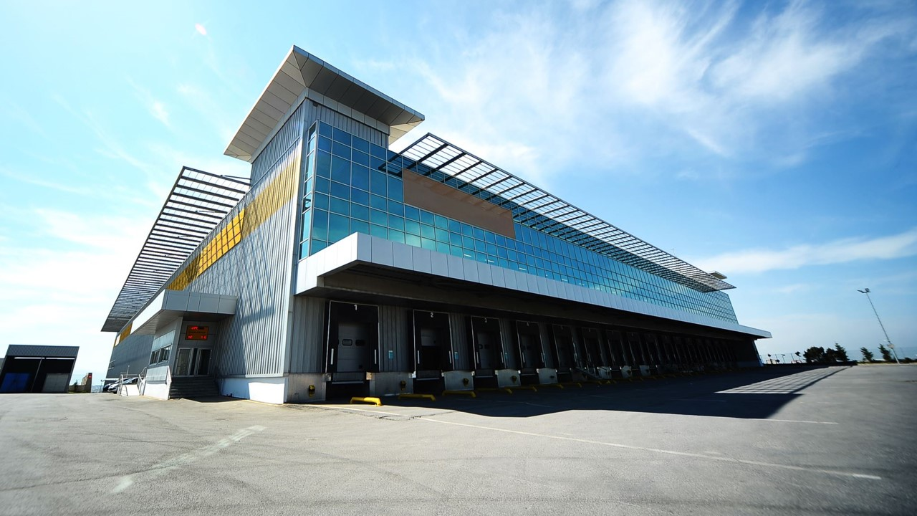
Business Model Canvas Generator
By Amr Mohamed
Supervised by Eng. Mohamed Walid

Slide 2
introduction
What is a Business Model Canvas (BMC)?
A strategic tool for developing new business models or documenting existing ones.
Consists of key areas such as Value Propositions, Key Activities, Customer Segments, etc.
Motivation
Entrepreneurs often face challenges in creating a well-structured BMC, especially without deep business experience.

Slide 3

Project Objective
Goal: To provide an AI-driven web-based tool that assists users in generating a comprehensive BMC automatically from a basic idea input.
Long-term Objective: Introduce an NLP model to refine and enhance BMCs using historical and generated data for smarter recommendations.

Slide 4

Problem Statement
Current Challenges:
Time-consuming: Creating a BMC from scratch requires extensive thought and research.
Complexity: Many struggle to structure their ideas into the key BMC categories.
Inconsistency: Manual creation may lead to overlooking crucial elements.

Slide 5

Solution Overview
AI-Powered Business Model Generation
Input a brief description of the business idea.
AI processes the input and generates a full BMC including Key Partners, Value Propositions, Customer Segments, etc.
The results are stored for future reference and can be downloaded as a PDF.

Slide 6

Target Audience
Entrepreneurs: Seeking efficient ways to create and refine business models.
Business Consultants: To help automate part of the planning process.
Startups: Needing fast and structured business modeling.
Technical Professionals: Understanding the architecture behind AI-powered business modeling.

Slide 7

Front-end web page
<HTML/CSS>
JavaScript (jQuery)
Architecture Overview
Frontend: Dynamic interaction through JavaScript (jQuery) and HTML/CSS.
Backend: Flask server handles requests and responses.
Database: SQLite stores BMC data for each user.
AI Integration: Generative AI model (LLM) processes business idea inputs to generate BMC suggestions.
User input (description)
AJAX calls, Flask-CORS
Back-end
Flask Framework
Sends description
Through API calls to LLM
Sends generated canvas data to DB
AI LLM
(Large Language Model)
DB
(SQLite)

Slide 8

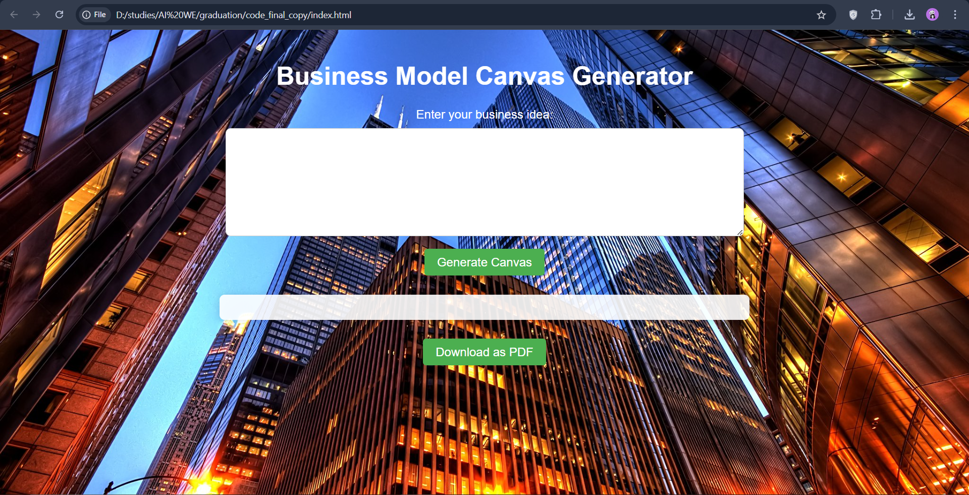
Demo

Slide 9
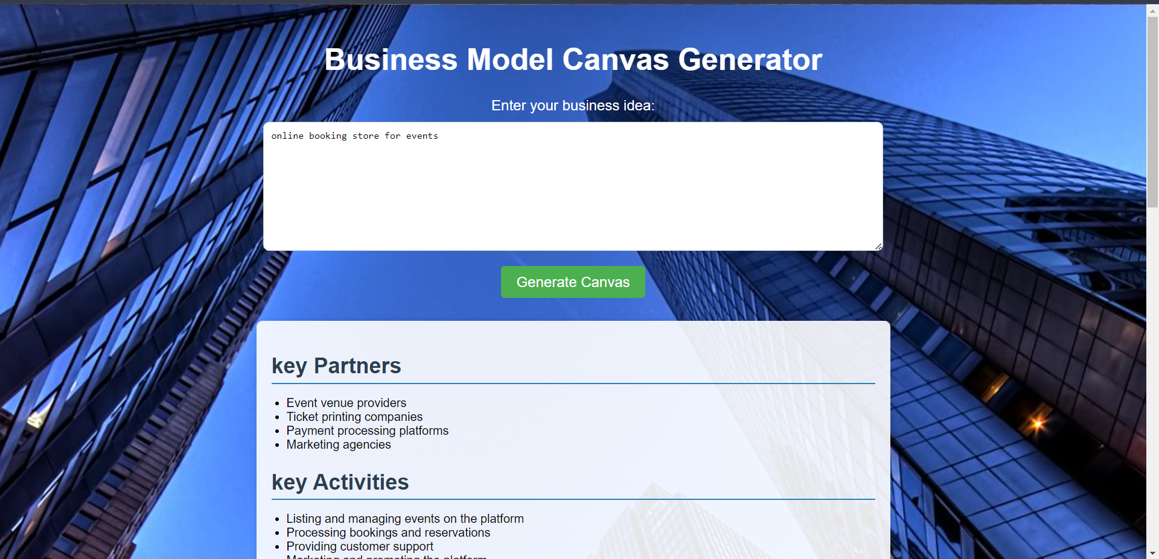
Demo

Slide 10
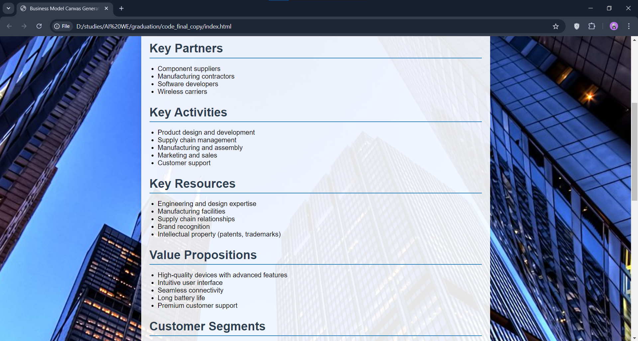
Demo

Slide 11

Conclusion
The BMC Generator is a step towards automating business model creation using AI.
It’s designed to save time and provide valuable insights for entrepreneurs and business professionals.
Try the tool and see how AI can help in shaping your business models.
Be ready for future releases with more advanced NLP-powered features.

Slide 12

Thank you Questions ?

